Slide 1
01-Kubernetes Overview

Slide 2
What you will learn in this course
As technology evolves, computing power has become more and more necessary to make applications run at scale.
To reach high availability, running an application on only one server is not the way to go. Instead, development teams started to use the power of computers cluster.
However managing cluster is extremely difficult, until Kubernetes came out.
Kubernetes is a tool that is used to orchestrate Docker containers and manage clusters, making application run at scale! In this course we will cover:
What is Kubernetes
How Kubernetes is structured
Kubernetes main components

Slide 3
Where does Kubernetes come from?
Have you ever heard of Gordon E. Moore?
He is the co-founder of Intel and he's famous for stating an observed law that is named after him: Moore's law.
It states the power of computers will double every two years. Impressive right? Well up until recently, we indeed observed that.
One of the reason why we observed that is because humanity actually needs more computing power. As our usage of technology grows so our use case requiring more computing power.
Machine Learning is a great example: to make an algorithm efficient, you need a lot of data!
To make powerful computers, you can do two things:
Scale Vertically -> Make one computer more powerful (with more CPU/GPU or RAM)
Scale Horizontally -> Distribute task over several computers

Slide 4
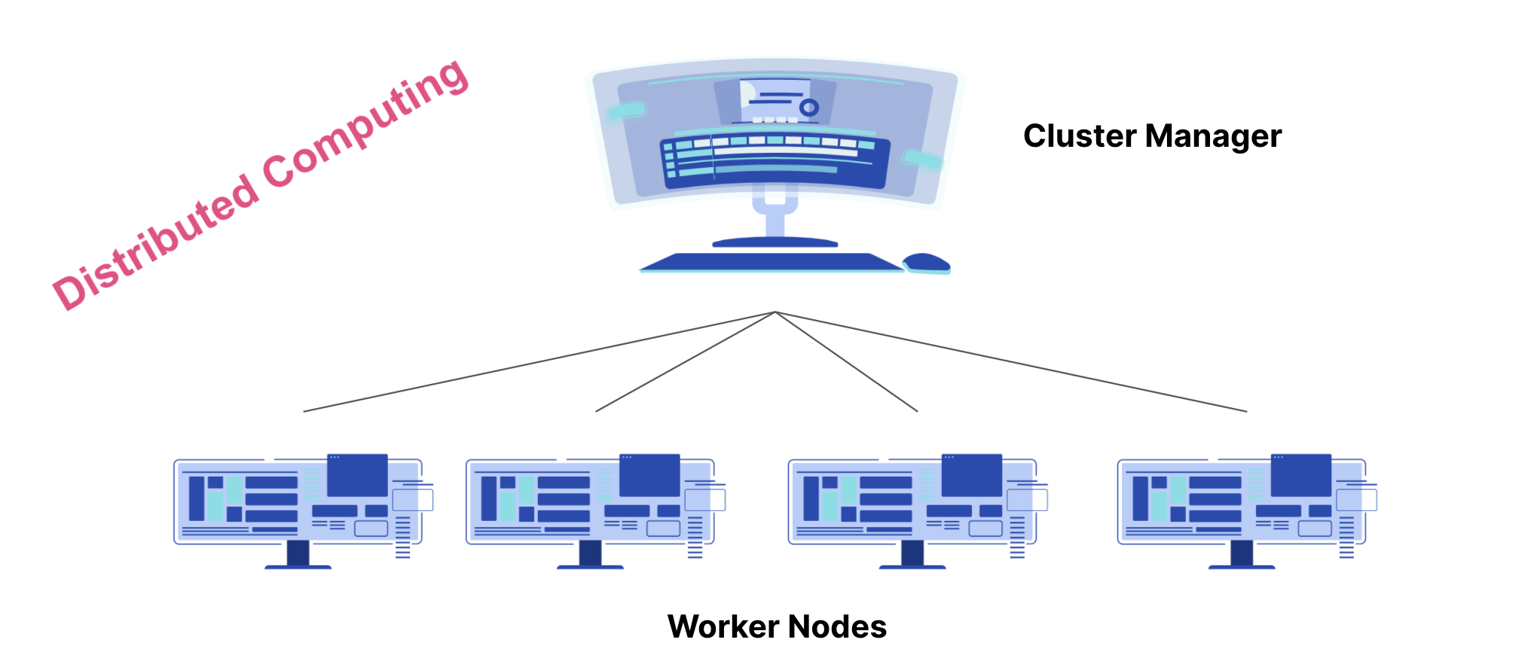
Where does Kubernetes come from?
Kubernetes is all about the second option and it basically works as show below:

Slide 5
How Kubernetes work?
At the heart of Kubernetes are containers running images.
This technology is indeed by essence very scalable as you can run, stop, kill containers very easily in a standardized environment.
Now all there is to do is to manage containers so that any application running on a Kubernetes cluster is completely fault-tolerant.

Slide 6
How Kubernetes work?
Kubernetes provides you with:
Service discovery and load balancing
Kubernetes can expose a container using the DNS name or using their own IP address.
If traffic to a container is high, Kubernetes is able to load balance and distribute the network traffic so that the deployment is stable.
Storage orchestration Kubernetes allows you to automatically mount a storage system of your choice, such as local storages, public cloud providers, and more.
Automated rollouts and rollbacks
You can describe the desired state for your deployed containers using Kubernetes, and it can change the actual state to the desired state at a controlled rate.
For example, you can automate Kubernetes to create new containers for your deployment, remove existing containers and adopt all their resources to the new container.

Slide 7
How Kubernetes work?
Kubernetes provides you with:
Automatic bin packing
You provide Kubernetes with a cluster of nodes that it can use to run containerized tasks.
You tell Kubernetes how much CPU and memory (RAM) each container needs. Kubernetes can fit containers onto your nodes to make the best use of your resources.
Self-healing Kubernetes restarts containers that fail, replaces containers, kills containers that don't respond to your user-defined health check, and doesn't advertise them to clients until they are ready to serve.
Secret and configuration management
Kubernetes lets you store and manage sensitive information, such as passwords, OAuth tokens, and SSH keys
You can deploy and update secrets and application configuration without rebuilding your container images, and without exposing secrets in your stack configuration.

Slide 8
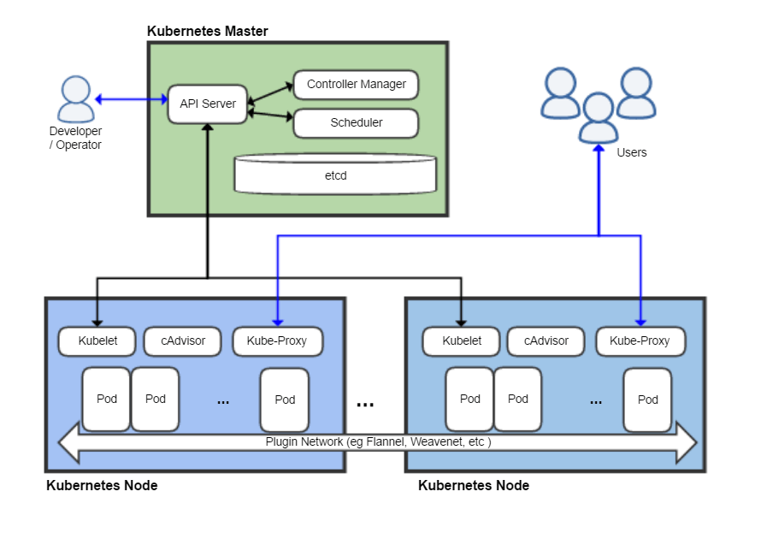
Kubernetes Structure
Kubernetes structure is quite complex to grasp at first but here is what you need to know:
All actual machines (physical or Virtual Machines) are called nodes
It is the actual machine that has all the necessary environment to run Kubernetes and Docker containers

Slide 9
Kubernetes Structure
Everything in Kubernetes is controlled by the control plane. It can be hosted on one seperate node or distributed across several nodes within the cluster. A control plane is composed of these components:
Controller Manager :
that is in charge of controlling if a given job is run properly (i.e -> Responding when a node goes down, launch a given task...)
etcd that is in charge of storing data about the cluster (Environment variables, metadata etc.).
👋 Though it shouldn't be used as a primary store database. It doesn't replace your postgreSQL DB, it's only for data about the cluster
Scheduler that is in charge of assigning a Pod to the right node.

Slide 10
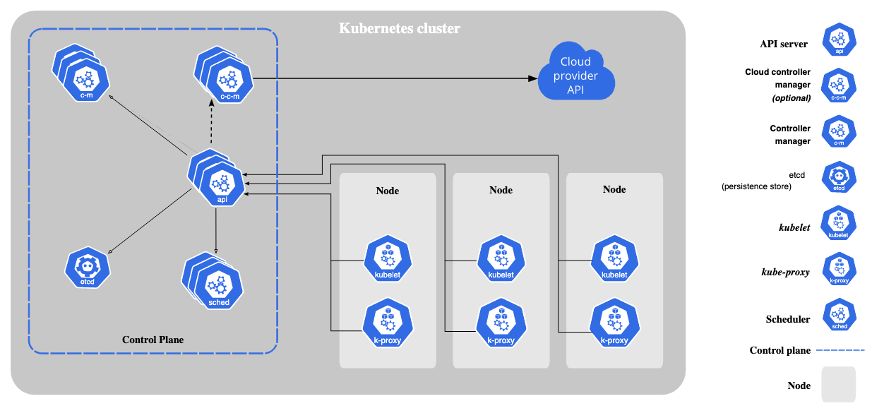

Slide 11
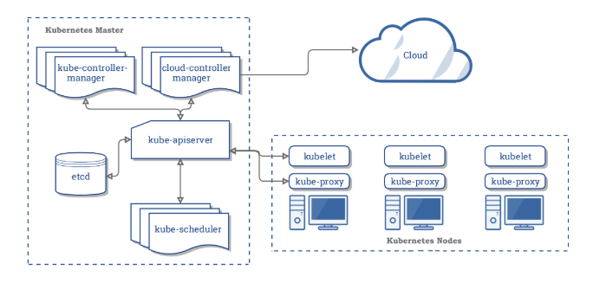
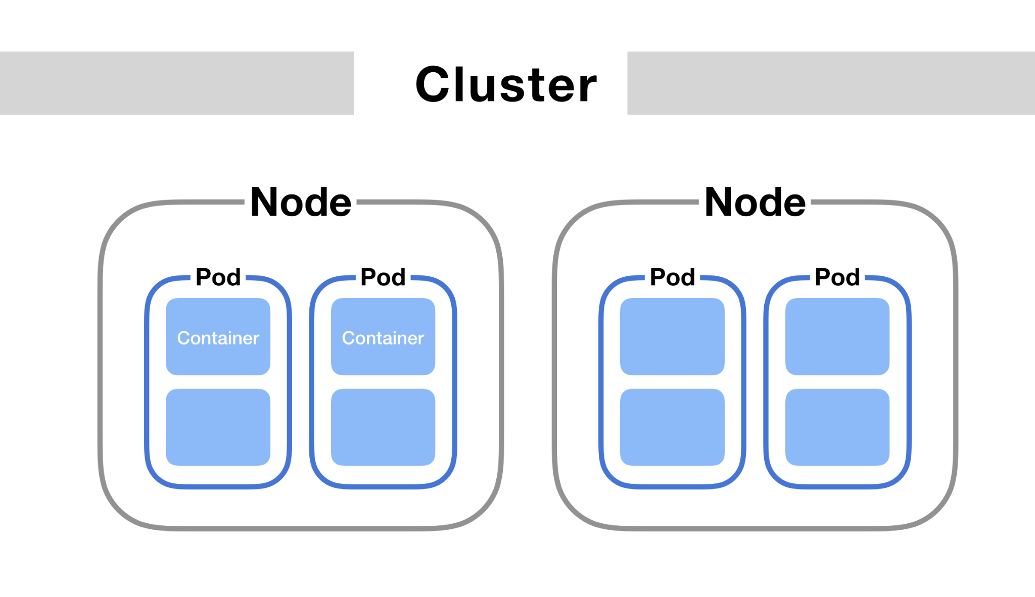
Kubernetes Structure
A Pod is a set of containers and volumes. There can be several Pods per Nodes and that's what is actually great about Kubernetes, Pods are decoupled from Nodes.
To manage Pods, a node has two components installed:
kubelet is used to assign a container to a Pod
kube-proxy handles networking between each nodes - to be able to communicate among nodes.

Slide 12
Kubernetes Structure
Finally, the way you interact with a Kubernetes cluster is with the API Server. It is a REST API that you can use several ways:
With yaml files --> most common ways
With a client library like Python
With cli commands

Slide 13
